Slide 1
Get Churn’t Implementing Heteroscedastic Variance for Churn Prediction
Daniel Berman, Andrew Wang, Emerson Wenzel

Slide 2
Project Goal
Telecom Companies:
Recruiting new customers costs 5x as much as retaining current customers
Six customers out of ten cite surprise rewards as a reason they stay loyal to a brand.
Telecom and technology companies have enormous stores of data on customers
Goal: Leverage data to predict which customers will churn
Classification problem:
Multi-dimensional input from company data on customers → Binary output (At risk of churning / not at risk)
2
Notes:
Telecom and technology companies collect data on thousands, if not hundreds of thousands, of attributes on their customers. And feed all of these attributes into a model to predict which customers will churn
Loyal customers feel betrayed if a company misuses the information that the customers provided to it. Nearly four out of five customers would abandon a favorite brand if the company used the customers’ personal data without first notifying them.
Define Project Goal (~ 1 slide)
Motivate the problem you are trying to solve and why it matters
Formulate the task (define input and output of computation system)
Target an audience of machine learning graduate students who have taken this class before, but who may not know much at all about your domain (e.g. reinforcement learning or computer vision or NLP or whatever)

Slide 3
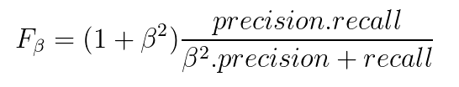
Research Question
For customer data, some areas of the input space will be more noisy than others
Hypothesis: Modeling variance across input space will lead to better predictive performance.
Accounting for heteroscedastic variance → downplay significance of noisy data → better performance
Performance Metric of Interest:
3
Notes:
Present a Research Question / Hypothesis (~1 slide)
Make claim about comparison between focus and baseline(s) methods
Identify measurable performance metric(s) appropriate to goal
Provide because/why reasoning that is plausible to domain experts

Slide 4
Baseline Method
Bayesian Neural Network
5 Layers, Hidden Size = 25
VI for posterior estimation
Models homoscedastic variance
Tuning: Homoscedastic Variance
Gridsearch over σ = [1e-6, 1e-4, 0.01, 0.25, 1, 25]
Input Layer
Hidden Layer (HL) 1
...
HL 5
μ
4
Notes:
Define a baseline method (~1 slide)
Precise description of major pieces (focus on model, some details on algo/implementation)
Emphasize at least one strength and at least one limitation
Strength: More straightforward to implement
Faster time to convergence
Highlight an important hyperparameter and how you set it

Slide 5
Focus Method
Input Layer
Bayesian Neural Network
5 Layers, Hidden Size = 25
VI for posterior estimation
Models heteroscedastic variance
Tuning: Learning Rate
Gridsearch over α = [1e-4, 1e-3, 0.01, 1 , 10]
Hidden Layer (HL) 1
...
HL 4
HL 5 μ
HL 5 log σ
μ
log σ
5
Notes:
Define a proposed/focus method (~1 slide)
Precise description of major pieces (focus on model, some details on algo/implementation)
Emphasize at least one strength and at least one limitation
Strength: Can learn noise inherent across different areas of the dataset, and diminishes influence of data from noisy areas of input space
Weakness: Longer training time, less stability
Highlight an important hyperparameter and how you set it

Slide 6



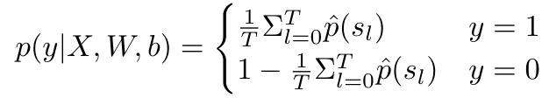
Likelihoods:
Baseline:
Focus:
6
Notes:
Variational inference General mean 0 variance 1 gaussian priors, and gaussian variational distribution with diagonal covariance (or independent gaussians)

Slide 7
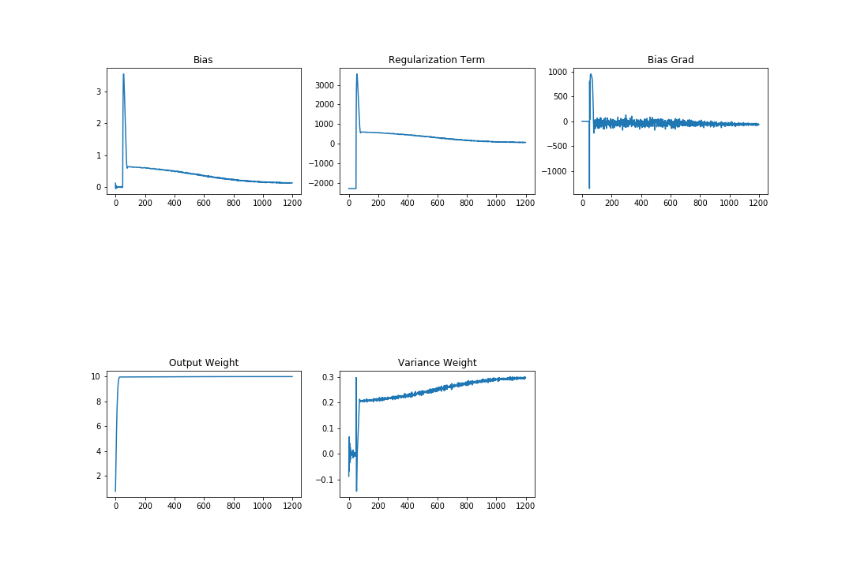
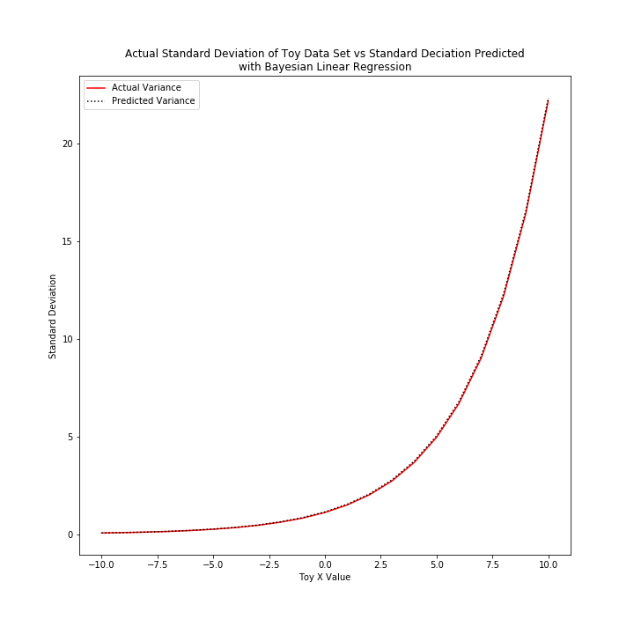
Experimental Results
Variance Weight
Bayesian Linear Regression on Toy Dataset:
Output generating process:
10 * x - 5
Variance generating process:
exp(0.3 * x)
20
Weight Value
15
Standard Deviation
Epoch
10
Variance Bias
5
0
Bias Value
-10
-5
0
5
10
Toy x Data
Epoch
7
Notes:
Provide Experimental Results on ONE dataset (pick most interesting) (~1 slide)
Dataset and evaluation protocol (esp. train/validation/test) clear and appropriate
Performance metrics are clear and appropriate
Focus and baseline methods compared with critical interpretation
Preliminary answer provided to the research question/hypothesis

Slide 8
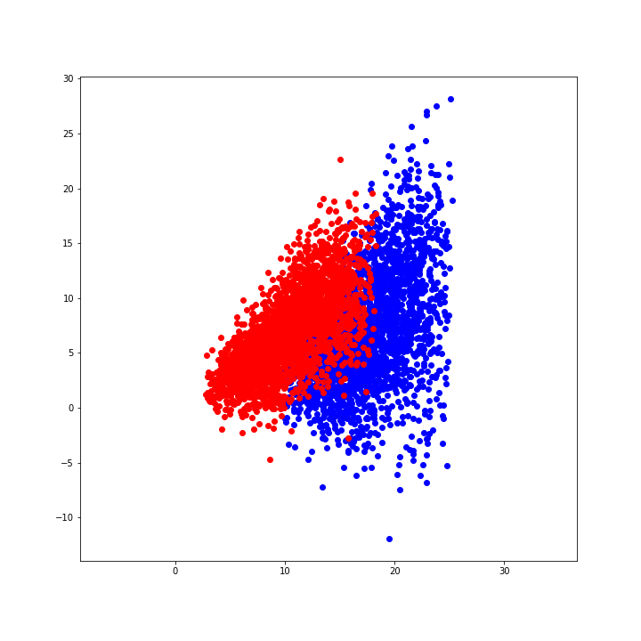
Experimental Results
(Focus) Bayesian Logistic Regression on Toy Dataset
F₅-score: 92.56
(Baseline):
F₅-score: 92.45
8
Notes:
Provide Experimental Results on ONE dataset (pick most interesting) (~1 slide)
Dataset and evaluation protocol (esp. train/validation/test) clear and appropriate
Performance metrics are clear and appropriate
Focus and baseline methods compared with critical interpretation
Preliminary answer provided to the research question/hypothesis

Slide 9
Reflection and Outlook
Remaining work:
Neural Network vs. Linear Model
Balanced → Unbalanced dataset
Linear relationships in toy dataset → non-linear relationships to learn in real dataset
BDL Methods:
Challenges exist in translating between pseudo Bayesian neural networks that approximate uncertainty and actual Bayesian neural networks
Churn prediction domain:
Sparsity of data (0’s and empty values)
Labeling of features (secrecy associated with company data)
Meaningfulness of labeled output in training data, and output of predictions (Timeline of churn)
8
Notes:
Provide a Reflection and Outlook (~1 slide)
Short-term future work is sensible (What will you finalize for the report?)
Summarize one key take-home lesson about BDL methods from your project
Summarize one key take-home lesson about your task/evaluation/domain (try to say something more exciting than "ML is hard")

Slide 10
Get Churn’t Implementing Heteroskedastic Variance for Churn Prediction
Daniel Berman, Andrew Wang, Emerson Wenzel

